Slide 1


SAP BTP Training
Cloud Foundry Training

Slide 2

DISCLAIMER
The training content and delivery of this presentation is confidential, and cannot be recorded, or copied and distributed to any third party, without the written consent of Anubhav Trainings

Slide 3

LEARNING OBJECTIVES
SAP BTP CAPM Development
Add UI Module to mta.yaml
App Router Concept
Implementing App router
Deploy and Test

Slide 4
Process Of Implementation
Create a New backing service instance for XSUAA
While creating this instance we need to pass our Role Configuration (JSON) = xs-security.json
Documentation for making xs-security file
https://help.sap.com/viewer/4505d0bdaf4948449b7f7379d24d0f0d/2.0.03/en-US/6d3ed64092f748cbac691abc5fe52985.html
We need to bind our app with this backing service
If we use Java, we need to add a security module (Spring) to restrict access to end points
https://github.com/SAP/cloud-security-xsuaa-integration
Deploy and Test our app
{
"xsappname": "07springodata",
"tenant-mode": "dedicated",
"scopes": [{
"name": "$XSAPPNAME.AnubhavDisplay",
"description": "To Display vendor data"
},
{
"name": "$XSAPPNAME.AnubhavEdit",
"description": "To Create new vendor data"
}
],
"role-templates": [{
"name": "Viewer",
"description": "View, Vendor Details",
"scope-references": [
"$XSAPPNAME.AnubhavDisplay"
]
},
{
"name": "Editor",
"description": "Edit and Create new Vendor Details",
"scope-references": [
"$XSAPPNAME.AnubhavEdit"
]
}
]
}
www.anubhavtrainings.com

Slide 5
Issues
Our app was giving wrong credentials when were running Fiori app with HANA
cds watch --profile hybrid
When we were trying to handle F4 Help, we were only getting technical IDs
When we create new PO and Items, the header data was creating but the item data was not
entity purchaseorder: cuid, common.Amount {
PO_ID: String(24);
PARTNER_GUID: association to master.businesspartner;
LIFECYCLE_STATUS: String(1);
OVERALL_STATUS: String(1);
NOTE: String(120);
Items: Composition of many poitems on Items.PARENT_KEY = $self
}
annotate CatalogService.PurchaseOrderItems with {
PRODUCT_GUID@(
Common: {
Text: PRODUCT_GUID.DESCRIPTION,
ValueList : {
Label : 'Badhiya',
CollectionPath : 'ProductSet',
SearchSupported : True,
Parameters : [{
$Type : 'Common.ValueListParameterOut',
LocalDataProperty : 'PRODUCT_GUID.DESCRIPTION',
ValueListProperty : 'DESCRIPTION'
},{
$Type : 'Common.ValueListParameterInOut',
LocalDataProperty : 'PRODUCT_GUID_NODE_KEY',
ValueListProperty : 'NODE_KEY'
}]
}
},
ValueList.entity : CatalogService.ProductSet
)
};
annotate CatalogService.POs with {
PARTNER_GUID@(
Common: {
Text: PARTNER_GUID.COMPANY_NAME,
ValueList : {
Label : 'Badhiya',
CollectionPath : 'BusinessPartnerSet',
SearchSupported : True,
Parameters : [{
$Type : 'Common.ValueListParameterOut',
LocalDataProperty : 'PARTNER_GUID_NODE_KEY.COMPANY_NAME',
ValueListProperty : 'COMPANY_NAME'
},{
$Type : 'Common.ValueListParameterInOut',
LocalDataProperty : 'PARTNER_GUID_NODE_KEY',
ValueListProperty : 'NODE_KEY'
}]
}
}
)
};

Slide 6













Slide 7
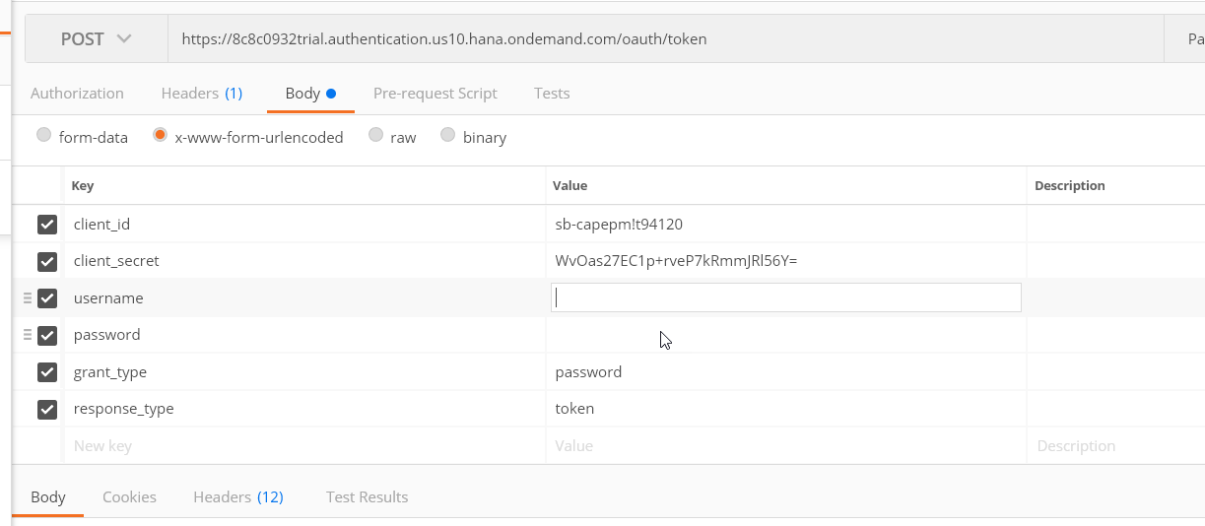
Obtaining JWT Token from XSUAA
Create a POST call to XSUAA service to obtain JWT token
Type: POST
URL : <url from CF>/oauth/token
Body – x-www-url-encoded
(examples)
client_id - <get from cf>
client_secret - <get from cf>
username – <pass your CF email id>
password – <your CF password>
grant_type – password
response_type – token
2. Call your Service - https://07springodata-smart-wolverine-rk.cfapps.eu10.hana.ondemand.com/anubhav.svc
Type: GET
Headers –
Authorization : Bearer <token which we obtain in last step>
Content-Type : application/json
www.anubhavtrainings.com

Slide 8



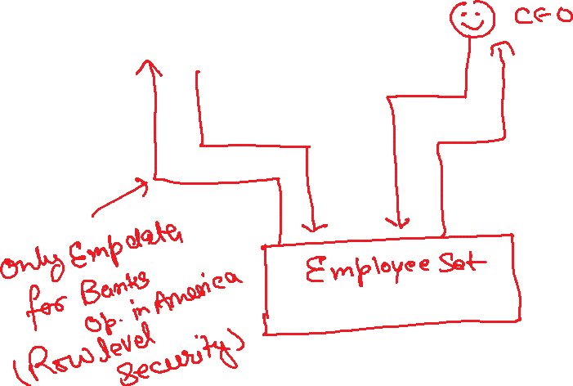







Authorizations Control
www.anubhavtrainings.com

Slide 9
Security – Authentication/Authorization
Create a entry for cloud foundry managed service of type xsuaa in mta.yaml file
Add that as a require resource into the system
Create a xs-security.json file with the required configuration, Roles, Role Template, Attribute
Go to xs-app.json file, add the authentication method as route And also add the "authenticationType": "xsuaa",
Install the dependencies for passport, @sap/xsenv, @sap/xssec
Add the configuration for security in package.json inside cds section
"uaa": {
"kind": "xsuaa"
}
Add authentication strategy with optional dev profile so that we can configure local test users
Make sure our resources are protected, CatalogService.cds, go and add authentication force and then authorization control for entity (Row level security)
@(requires: 'authenticated-user')
@(restrict:[
{
grant: ['READ'],
to: 'Viewer',
where: 'bankName = $user.BankName'
},
{
grant: ['WRITE'],
to: 'Admin'
}
])
www.anubhavtrainings.com

Slide 10
Expose APIs - Secure our data to internet
SAP Cloud Connector
Internet
Intranet
mys4hanaserver.company.com
8021
1
4
On-premise
BPC,BW,ECC,S/4
SAP BTP
BAS
2
Secure by SSH
SAP Cloud Connector
3
What is cloud connector?
On-premise connectivity
How to build a Fiori App on BAS using On-premise?
https://help.sap.com/viewer/cca91383641e40ffbe03bdc78f00f681/Cloud/en-US/e54cc8fbbb571014beb5caaf6aa31280.html
www.anubhavtrainings.com

Slide 11
If I already have a functionality in my core, how can I reuse?
Pre-requisite- Create OData Services on top of your ABAP code/ BAPIs, Workflows, BOPF, CDS, BADIs, Exits
Recommend – ABAP on HANA (CDS based OData Services) + UI5 and OData Training (SEGW based Free style services) + Third Party (.NET, legacy, Java Based portal – REST Services)
SAP Standard – SAP Delivers lots of ERP Functionality, SAP Started delivering read-to-use out-of-box APIs – SOAP, ODataV2, ODataV4
https://api.sap.com
SAP Business API HUB – Central place for all the offered APIs for integration purpose.
Difference between SOAP and OData
https://www.youtube.com/watch?v=v_xPlRumdbE
Server access for S/4HANA for your learning on demand
server@anubhavtrainings.com
Cost 2500 INR per month per user / 40 USD
Latest S/4HANA service to build CDS Views, Fiori Apps, Integrations
www.anubhavtrainings.com

Slide 12
Title
SAP Fiori Launchpad
Html repo.
SAP Fiori App
destination
SAP Fiori App
SAP Fiori App
BAS
SAP Fiori App
SAP Fiori App
Destination
S/4HANA
SCC
www.anubhavtrainings.com

Slide 13
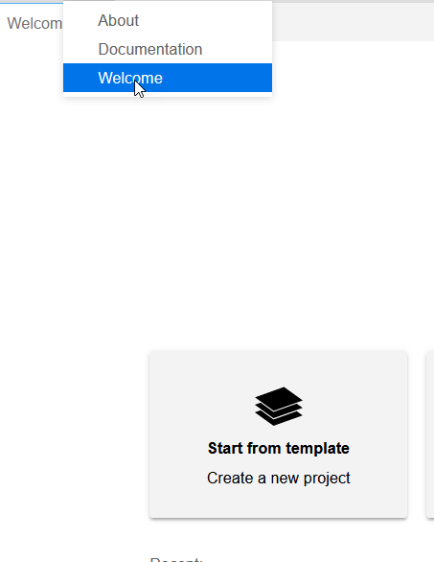
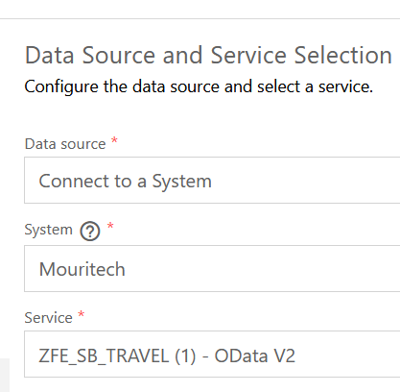
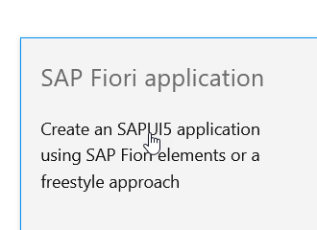
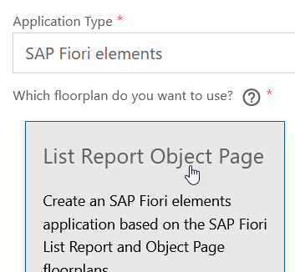
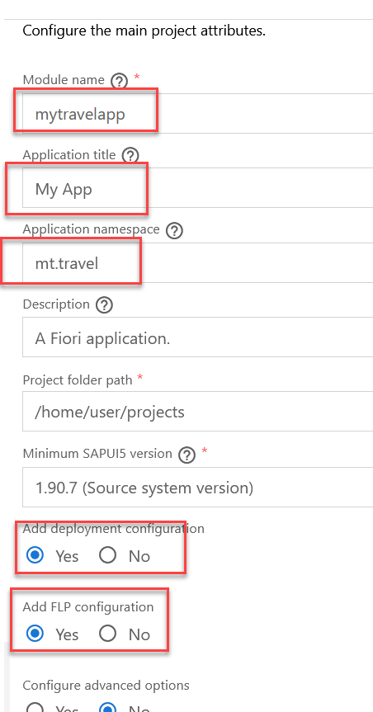
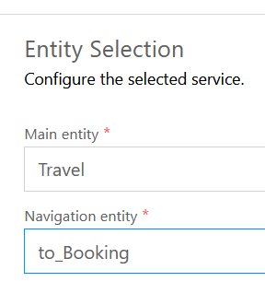
Title
www.anubhavtrainings.com

Slide 14
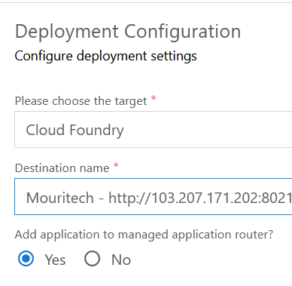
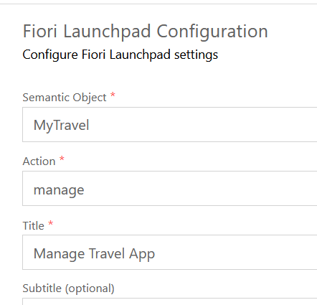
Title
www.anubhavtrainings.com

Slide 15
Title
www.anubhavtrainings.com

Slide 16
URL
xs-app.json
routes
AppRouter – Node Module - @sap/approuter
Provide single entry point for application
Interservice communication w/o CORS
Help in security
ui
srv
srv2
srv3
/pord/index.html
/catalogsrv
/myservice
/newsrv3

Slide 17
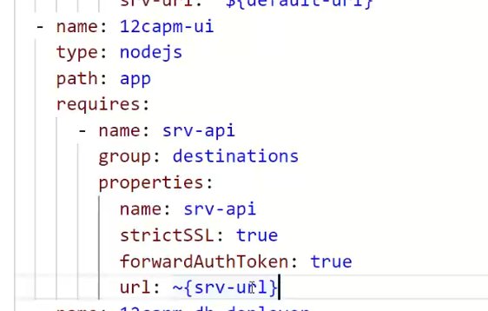
Add UI Module manually
- name: capbasic-ui
type: nodejs
path: app
parameters:
buildpack: nodejs_buildpack
requires:
- name: srv-api
group: destination
properties:
name: srv-api
strictSSL: true
forwardAuthToken: true
url: '~{srv-url}'
www.anubhavtrainings.com

Slide 18
App Router
It is a node js Application
It is used to automate our process of authorization and XSUAA token management
Redirects the access of our Microservice to XSUAA, XSUAA redirects it to IDP
IDP sends the login screen to the user, user authenticates and XSUAA release a JWT Token
App Routes takes this JWT Token, validates it and fowardAuthToken to the microservice
It serves as a single entry point for our application which perhaps has multiple microservices inside.
This configuration of each microservice to which we need to re-direct is managed using a configuration file which app router will use called xs-app.json
URL
App Router
(Reverse Proxy, Single Entry point, Façade)
xs-app.json
Java
/anubhav.svc
Node
/vendors
Fiori UI5
/index.html
www.anubhavtrainings.com

Slide 19
Banking example from Real world
1
Single entry point
(App Router)
xs-app.json
Bank Service
(Microservice)
0145
6
2
Locker
5
Gold Loan
authentication
IB
IDP
JWT
Home Loan
3
Token Machine
XSUAA
ROLES
Core banking
4
Xsuaa backing service
0145
Cheque Service
RD and FDs
authorization
www.anubhavtrainings.com

Slide 20
xs-app.json App Router Configuration
{
"welcomeFile": "purchaseorderapp/webapp/",
"authenticationMethod": "none",
"sessionTimeout": 10,
"pluginMetadataEndpoint": "/metadata",
"routes": [
{
"source": "^/purchaseorderapp/webapp/(.*)",
"target": "$1",
"localDir": "purchaseorderapp/webapp/"
},
{
"source": "^/(.*)$",
"destination": "srv-api"
}
]
}
www.anubhavtrainings.com

Slide 21
Authentication v/s Authorization
Authentication – Are you a valid user? User credentials validated. – user Account
Authorization – What is user allowed to access with the app?
XSUAA – User Account and Authorization
This is a in-built component inside of SAP CF
It is responsible to control the User account and Authorization
In Cloud Foundry, we can use a modular concept for managing Authorizations
We need to register our Scopes, Role Templates related to the app with XSUAA
Communicates with IDP
Issues JWT Tokens which is then injected in our App which has information about Scope(Role) user has
Scope
(Role)
Role Templates
Role Collections
* *
* *
* *
www.anubhavtrainings.com

Slide 22
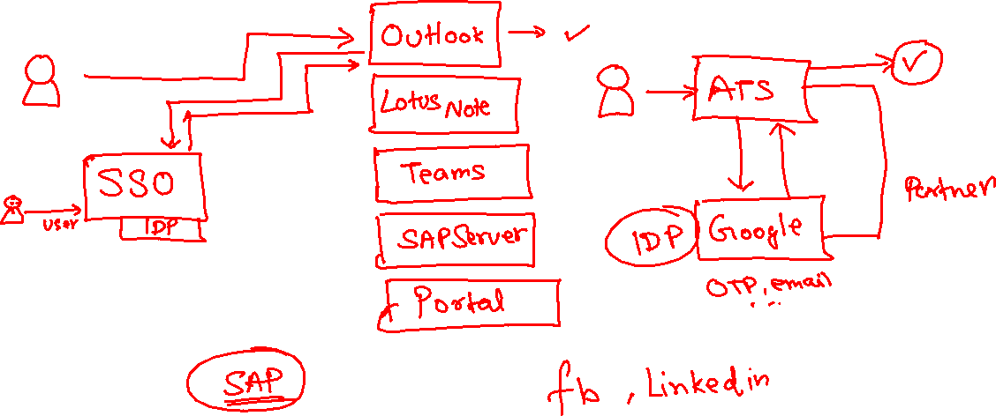
IdP – Identity Provider
www.anubhavtrainings.com

Slide 23
Process Of Implementation
Create a New backing service instance for XSUAA
While creating this instance we need to pass our Role Configuration (JSON) = xs-security.json
Documentation for making xs-security file
https://help.sap.com/viewer/4505d0bdaf4948449b7f7379d24d0f0d/2.0.03/en-US/6d3ed64092f748cbac691abc5fe52985.html
We need to bind our app with this backing service
If we use Java, we need to add a security module (Spring) to restrict access to end points
https://github.com/SAP/cloud-security-xsuaa-integration
Deploy and Test our app
{
"xsappname": "07springodata",
"tenant-mode": "dedicated",
"scopes": [{
"name": "$XSAPPNAME.AnubhavDisplay",
"description": "To Display vendor data"
},
{
"name": "$XSAPPNAME.AnubhavEdit",
"description": "To Create new vendor data"
}
],
"role-templates": [{
"name": "Viewer",
"description": "View, Vendor Details",
"scope-references": [
"$XSAPPNAME.AnubhavDisplay"
]
},
{
"name": "Editor",
"description": "Edit and Create new Vendor Details",
"scope-references": [
"$XSAPPNAME.AnubhavEdit"
]
}
]
}
www.anubhavtrainings.com

Slide 24
Obtaining JWT Token from XSUAA
Create a POST call to XSUAA service to obtain JWT token
Type: POST
URL : <url from CF>/oauth/token
Body – x-www-url-encoded
(examples)
client_id - <get from cf>
client_secret - <get from cf>
username – <pass your CF email id>
password – <your CF password>
grant_type – password
response_type – token
2. Call your Service - https://07springodata-smart-wolverine-rk.cfapps.eu10.hana.ondemand.com/anubhav.svc
Type: GET
Headers –
Authorization : Bearer <token which we obtain in last step>
Content-Type : application/json
www.anubhavtrainings.com

Slide 25
Authorizations Control
www.anubhavtrainings.com

Slide 26
Security – Authentication/Authorization
Create a entry for cloud foundry managed service of type xsuaa in mta.yaml file
Add that as a require resource into the system
Create a xs-security.json file with the required configuration, Roles, Role Template, Attribute
Go to xs-app.json file, add the authentication method as route And also add the "authenticationType": "xsuaa",
Install the dependencies for passport, @sap/xsenv, @sap/xssec
Add the configuration for security in package.json inside cds section
"uaa": {
"kind": "xsuaa"
}
Add authentication strategy with optional dev profile so that we can configure local test users
Make sure our resources are protected, CatalogService.cds, go and add authentication force and then authorization control for entity (Row level security)
@(requires: 'authenticated-user')
@(restrict:[
{
grant: ['READ'],
to: 'Viewer',
where: 'bankName = $user.BankName'
},
{
grant: ['WRITE'],
to: 'Admin'
}
])
www.anubhavtrainings.com

Slide 27

Summarize
LET’S SUMMARISE!

Slide 28

Summarize
End of Day 15

Slide 30


We’re committed to empower you to be
#FutureReady
through powerful training solutions.
We build the workforce of the future.
250+
Corporate Clients
30,000+
Learners Trained
25000+
Learners Placed
FREE WEBINARS
Sign up for free webinars with industry experts every fortnight!
Enroll Now!
Contact us today!
https://anubhavtrainings.com

